Slide 1
Minemeld & The importance of Centralized threat intelligence
Jamila Kaya
B-Sides 2019

Slide 2
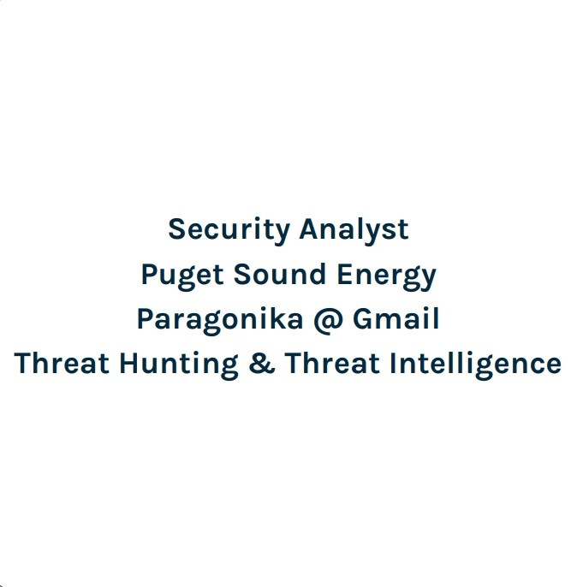


Slide 3
What is Threat Intelligence?
“[…] Evidence-based knowledge, including context, mechanisms, indicators, implications and actionable advice, about an existing or emerging menace or hazard to assets that can be used to inform decisions regarding the subject's response to that menace or hazard.” (Gartner, Definition: Threat Intelligence)

Slide 4
What is Threat Intelligence? (Really)
IP Addresses
Email Addresses & Subject Lines
Filenames & Hashes
Mutexes and Patterns
Domain Names & URLs
Countries, Top Level Domains, MAC Addresses, Device Types, Applications & Protocols…

Slide 5
Bad Behavior
Many organizations fall prey to bad habits by improperly scoping what it is they want to achieve with a threat intelligence program.
Vendor Promises of “Plug-and-Play”
Overly Generalized Intel
Feed Fatigue

Slide 6
Bad Behavior
Moreover, massive quantities of valuable threat intelligence is organization specific. This data is often land-locked within departments or technologies and not analyzed.
Over-Reliance on Subject Matter Experts and Assumptions
Orphaned or Unrecognized Data Value
Industry Intel Ghosting

Slide 7
What is Centralized Threat Intelligence?
A methodology intended to provide generalized “Intelligence” as a managed service for integration at enforcement points within an organization in a simplified way.
“Centralized” simply refers to the orchestration component of assuring that all data your systems are dynamically reacting to is colocated and managed by the same standards and control process.
“Threat Intelligence” in this context refers to Threat, Benign and Operational data points. All data points able to be actioned upon counts as “Intelligence”.

Slide 8
Improving Efficiacy
Central Threat Intelligence is a way of considering the work that security personnel do every day as providing immediate value. It translates external and internal research into value for other technologies.
Daily research, bulletins, community feedback, industry trends and internal communal knowledge can be transmuted into an intelligence engine to shed light on the threats we look into every day.
By maturing an intelligence regime, previously untenable value translations become possible. One such example being external threat sharing.

Slide 9
Scoping the Intel Issue
What are You Currently Doing to Gather or Desseminate Intelligence?
What are Your Enforcement Points?
What are Your Use Cases?
Who do You Trust?
Who Trusts You?
How Much Money and Time do You Have?

Slide 10

What is MineMeld?
An Open-Source Application that Manages Your Threat Intelligence & Other Things
Owned and Published by Palo Alto Networks
Available Free of Charge on Their Github

Slide 11
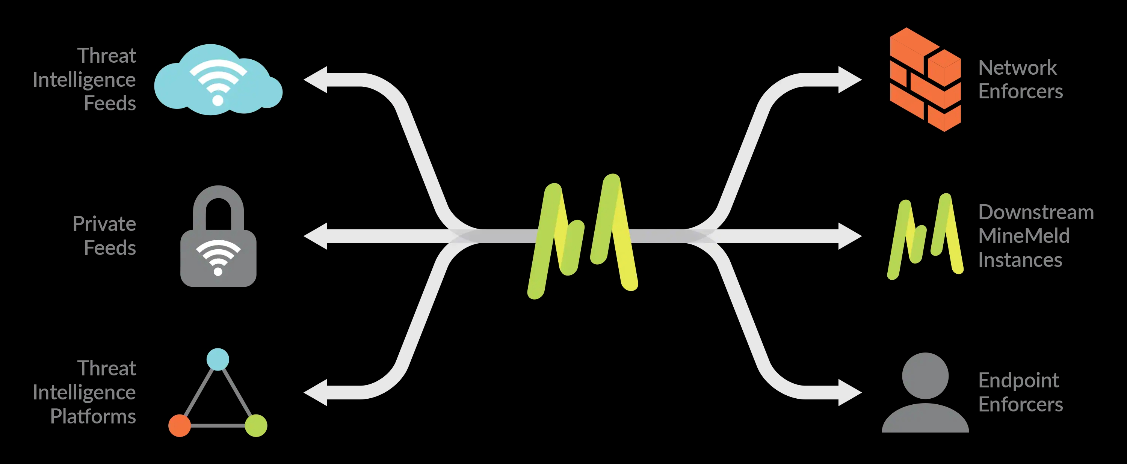

What Can I do with It?
Pretty Much Anything
Intake & Output & Aggregate & Deduplicate & Filter & Authenticate & Automate

Slide 12
Tech Specs to Start?
Simple 4-Minute Manual Install on Ubuntu 14.04
Ansible Playbook for Additional Linux Versions / OS
Pre-Built VMs Available for AWS & Azure & VMWare
Absolute Minimum of 1 GB RAM & 8 GB Disk
99+ Nodes Per Dual Core System
Management API for Automation

Slide 13
Installation Demo
https://youtu.be/nqPriMPtotw

Slide 14
Configuration Possibilities
Software Itself Can Handle Multi-Million Indicator Pools and Filter Funnels
1 Million is A Hard Cap at the Processor – Output Level
Stucturing Severity & Hazard Types Based on Organizational Need
Built-In and Custom Tagging and Node Creation Tailors Data to Your Needs
Whitelist Prefixes Turn Miners into Anti-Miners and Scrape Known Good
Assure Fast Response for Blocks
Prevents Trusted IP Ranges or Other Data from Being Blocked Dynamically

Slide 15
Configuration Demo
https://youtu.be/Gut2_wGgwVQ

Slide 16
Customization Depth
Clone and modify existing Prototypes from the WebUI
Create entirely new Prototypes in Python in the CLI
Scrape and Collect Strings from Lists and Websites to Customize Source Material
Top 10 Most Abused TLD
Youtube Channel Uploads
Organizational IP Space
Domain Squatting Registrations

Slide 17
Life After Commit
Be Creative
Don’t Forget to Create Scalability in Your Design
Use Your Existing Knowledge and Vendors as Resource
Start Small and Make the Case for Organizational Change
Reach Out to Other Departments for Ideas and Use Cases

Slide 18
Integration Opportunities
Existing Intelligence Packages Can be Utilized As Miners
Recorded Future, Anomali, Autofocus, ProofPoint, Infoblox ActiveTrust
TAXII and EDL Outputs Integrate With Internal Enforcement Points
Custom Outputs Can Also Be Crafted to Assure the Formate Is Appropriate
Non-Supported Solutions Can Still Be “Tricked” Into Support
A SIEM or Any System That Supports Static List Entry

Slide 19
Operational Opportunities
Existing Operational Whitelists and Exception Policies Can Be Integrated
Maintenance of Firewall Exceptions Can Be Simplified
Access to MineMeld API Can be Leveraged Through Additional Tooling
Allowing Integration into Existing Orchestration Frameworks

Slide 20
Automation Opportunities
Provide Automated Report Delivery of Threat Changes
Domain Squatting Registrations Can be Delivered to Security and Legal Teams
MineMeld API and Integrations Can Be Integral to Incident Response
Blacklisting or Whitelisting During an Incident Can Help IR Teams Move Quickly
Built-In Support for Age-Out, Classification, and Comments

Slide 21
Automation Demo
https://youtu.be/6Lvgo9IXcxA

Slide 22
Proving Value
Integrate Freely with Non-Blocking Enforcement to Collect Case Data
SIEMS & Firewalls are Valuable in Proving the Risk of Intel Integration
Paves the Road for Implementation
Document. Document. Document.
Metrics on Bulk Nodule Collection Are Easy to Collect
Graphs are Built-In to Help Describe the Collection Process

Slide 23
Questions?

Slide 24
Resources for the Road!
Minemeld Github
https://github.com/PaloAltoNetworks/minemeld
SpamHaus Top Abused TLD
https://www.spamhaus.org/statistics/tlds/
Recorded Future IOC Gathering Plugin
https://chrome.google.com/webstore/detail/recorded-future/cdblaggcibgbankgilackljdpdhhcine

